Slide 1


Development of a Smart and Centralized Vehicle Rental Platform for Sri Lanka Using Geo-location and Real-Time Availability Features
Team Name: Initiators
Group No: 35
Supervisors: Mr. L. Fernando, Mr. Kasun Arrathanage
Team Members:
  K.H.S.N Udayanga - 421450766
  H.K.J.S Kumara - 221444633
  E.A.W.K.Edirisinghe - 521643036
  W.A.D.T. Rasindu - 420263726
  K. G. D. C. Silva - 519218340

Slide 2

Contents
  Title Page
  Introduction and Problem Addressed
  Aim & Objectives
  Findings From Literature Review
  System Overview
  Functional Requirements
  Non-functional Requirements
  Development Environment & Tools
  Quality Assurance & Deployment Strategy

Slide 3


Introduction
According to our initial observations, Sri Lanka's vehicle rental industry operates in a highly fragmented manner, with rental operators working independently using manual processes or isolated booking systems. This fragmentation creates significant challenges for both service providers and customers.
Problem Addressed
How can a smart and centralized vehicle rental platform, incorporating geo-location and real-time availability features, be effectively developed and implemented in Sri Lanka to enhance accessibility and efficiency for both tourists and local residents?

Slide 4
Aim
Development of a Smart and Centralized Vehicle Rental Platform for Sri Lanka Using Geo-location and Real-Time Availability Features
Objectives
Provide real-time vehicle listings with geo-location tracking
Implement intelligent location-based recommendations
Enable advanced search and filtering capabilities Support diverse vehicle types (cars, vans, bikes, tuk-tuks, etc.)
Integrate chatbot assistance for seamless customer support
Bridge the gap between urban and rural rental services

Slide 5



FINDINGS FROM LITERATURE REVIEW
Studies highlight that the demand for car-sharing and vehicle rental platforms is rising due to urban congestion, increased tourism, and growing smartphone penetration. Platforms such as Zipcar, Turo, and Uber demonstrate how centralized architectures coupled with intelligent back-end analytics can enhance operational efficiency and customer convenience
Proven Factors of Success in Vehicle Rental Applications
Centralized services
Automated payments
Location awareness
Real-time synchronization
Intuitive user interfaces
Perceived control

Slide 6
FINDINGS FROM LITERATURE REVIEW
Literature Gap Identified:
A clear literature gap is available in Sri Lanka for integrating a smart, simple, user-centric, centralized vehicle-rental platform, for the country’s transport ecosystem.

Slide 7
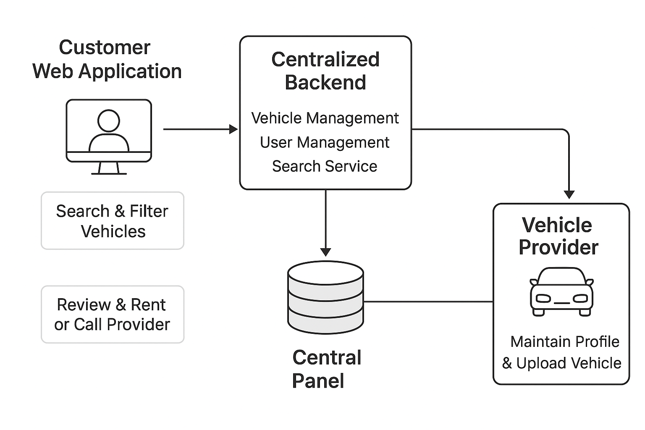

SYSTEM OVERVIEW

Slide 8
FUNCTIONAL REQUIREMENTS
PROPOSED SOLUTION: A self-intutive web application that acts as a bridge between individual vehicle providers and customers who wants to use those vehicle for rent. The application should support bellow mentioned functional requirements, and it creates a platform that promotes trustful services and responsible vehicle handling from vehicle providers and customers respectively.
1. User Management System
Multi-role registration, authentication, profile management, role-based access
2. Real-Time Vehicle Listings
Live GPS tracking, availability updates, WebSocket integration
3. Intelligent Search & Filtering
Geo-location search, filters (type, price, duration, driver), sorting

Slide 9
FUNCTIONAL REQUIREMENTS
4. Location-Based Recommendations
Personalized suggestions, traffic-aware routing, preference analysis
5. AI-Powered Chatbot
24/7 automated assistance, FAQs, inquiries
6. Booking & Reservation System
Real-time booking, confirmations, modifications, history tracking
7. Rating & Review System
Post-rental ratings, reviews, aggregate scores, moderation
8. Communication Tools
In-app messaging, push notifications, email alerts
9. Administrative Dashboard
User management, listing moderation, dispute resolution, analytics
10. Responsive Web Interface
Mobile-optimized, cross-device compatible, PWA capabilities

Slide 10
NON-FUNCTIONAL REQUIREMENTS
RELIABILITY
Consistent vehicle availability data, accurate GPS tracking, dependable booking system, minimal downtime
USABILITY
Easy vehicle search, simple booking process, clear navigation, accessible for all user types.
Works on all devices, supports all major browsers, responsive on mobile/tablet/desktop
RESPONSE TIME
Real-time vehicle location updates, instant search results, smooth map rendering, fast booking confirmations
Quick search results, instant chatbot responses, fast map loading, immediate booking confirmations
Scalability
Handle growing vehicle listings, support increasing user base, expand to new regions

Slide 11
Development Environment & Tools
Frontend Development
HTML5, CSS3, jQuery for dynamic interactions and responsive design
Backend Development
Laravel (PHP) framework with MVC architecture, RESTful API implementation
Database
MySQL for relational data management and complex queries
Real-Time Features
WebSocket (Laravel Echo) for live vehicle tracking and instant notifications
Mapping & Location Services
Google Maps API / OpenStreetMap for GPS tracking, geo-location search, and route optimization
Recommendation Engine
Lightweight collaborative-filtering with rule-based heuristics using traffic and past-booking data
Version Control
GitHub repository with Git branching strategy (development, staging, production)
Coding Standards
PSR-12 PHP coding standards, Laravel best practices, descriptive naming conventions, modular architecture

Slide 12
Quality Assurance & Deployment Strategy
Testing Approach
Unit testing (PHPUnit), Integration testing (Postman), UI testing (Selenium/Laravel Dusk), Performance testing (JMeter)
Testing Coverage
Vehicle search and filtering, booking flow, real-time GPS updates, payment processing, chatbot responses, user authentication
User Acceptance Testing (UAT)
Beta testing with rental operators, tourists, and commuters in urban and rural Sri Lankan areas
Deployment Platform
Hosting: Shared hosting / VPS (HostGator, SiteGround) or cloud (AWS/DigitalOcean free tier)
Database
MySQL on cloud or shared hosting with automated backups
Domain: Free domain or affordable .lk domain for Sri Lankan market
CI/CD Pipeline
Automated testing with GitHub Actions, deployment via FTP/SSH, Laravel migration scripts
Monitoring & Maintenance
Laravel logging (Monolog), error tracking, database backup automation, performance monitoring.
Supportability
Comprehensive documentation, modular Laravel structure, easy bug fixes, scalable architecture for feature updatesRetryClaude can make mistakes. Please double-check responses.

